Slide 1
DevOps For Databases
Automation with Bilal Shahzad

Slide 2
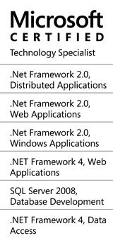
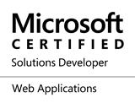
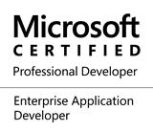
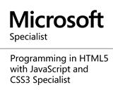

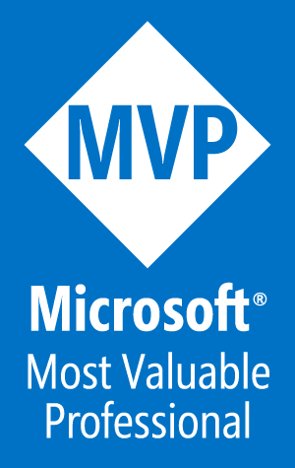
Trainer
https://www.linkedin.com/in/bilalshahzad139/
https://www.facebook.com/LearningInUrduCentre/
https://www.youtube.com/c/LearnInUrdu139
http://learninginurdu.pk
@bilalshahzad

Slide 3
Agenda
CI vs. CD vs. CD.
How do we handle DB changes currently?
Database Delivery approaches
Demo with SSDT for Databases
Referencing different Databases
Build using commands => Automation
Pre/Post deployment scripts
What is next?

Slide 4
Our Ultimate Objective
Every manual operation in your delivery pipeline needs to be evaluated to determine if it can be automated.
Ok, Can we automate deployment of DB changes (like code?)

Slide 5
CI vs. CD vs. CD
Continuous Integration (CI): A DEV practice to integrate code into a shared repository several times a day. Automated Tests are run on every integration.
Continuous Delivery (CD): Continuous delivery is an extension of CI to make sure that you can release new changes to your customers quickly in a sustainable way.
Continuous Deployment (CD): With this practice, every change that passes all stages of your production pipeline is released to your customers. There's no human intervention.

Slide 6
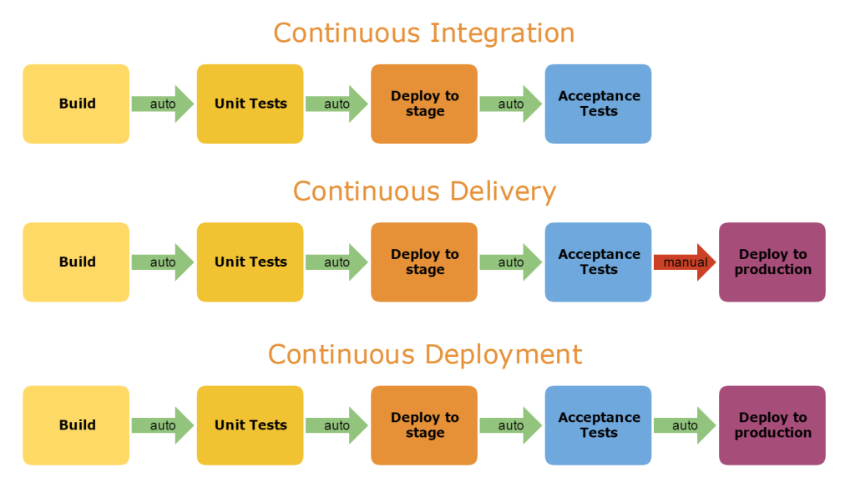
CI vs. CD vs. CD

Slide 7
How do we deploy/integrate Database Changes?
Treat it differently than code?
Shared Server?
No Source Control? No Change Tracking? No Direct Review or Approval Process like Merge Requests
Manually Keep track of changes/scripts in some format?
Execute those manually on Target Environment (e.g. QA, UAT)?
Sometimes work directly on database (e.g. Production)?
No easy way to bring database to a specific state (e.g. backups?)
Use any comparison tool to see the schema/data difference?
Do we delete existing database and recreate it like we deploy code?

Slide 8
Database Delivery: State based vs. Migration based
Migration Based
You start with initial database scripts
Then you keep scripts for new changes
Migration history is maintained in a table
When you execute, Framework checks what changes are new (using history table) and executes them.
Your source of truth is how the database should change
To create a fresh copy of DB, framework will execute all scripts from “initial database version”
Finding change history of a specific DB object becomes difficult
Example: Entity Framework Migrations, FlywayDB, Liquibase

Slide 9
Database Delivery: State based vs. Migration based
State Based:
Your source of truth is how the database should be
You maintain full “schema”/scripts of your database objects in source control.
When you want to make change, you change specific script file.
Using Schema compare/Diff tools, you generate scripts for deployment.
At any time, you can create a new database using this “full” schema.
No migration history is maintained in DB level.
Example: SQL Server Data Tools (SSDT), Red Gate Migrations Tool

Slide 10
So from where one should start?
Decide which approach you want to follow? State or Migration?
Bring database scripts to Source Control
Maintain DB changes alongside code.
Every commit should include Code + Relevant DB changes.
Hence related DB changes should be deployed with every code deployment.
Automate Delivery of DB changes in your Deployment Pipeline

Slide 11
What is SSDT?
SQL Server Data Tools
SQL Server Databases (We are going to discuss this)
Analysis Services (AS)
Integration Services (IS)
Reporting Services
State based approach
You create T-SQL scripts of all objects of database in Visual Studio
You get basic features of VS (e.g. Intelligence, Build etc.)

Slide 12
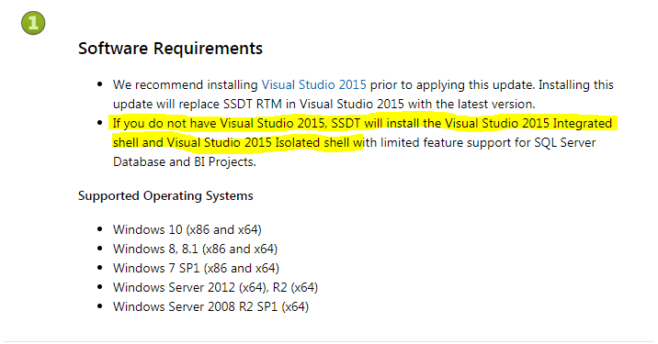
SSDT Installation
VS 2015 (https://msdn.microsoft.com/en-us/mt186501.aspx)
You can skip other & install only SSDT for Databases
VS 2017 (SSDT for Databases can be installed during VS 2017 installation)
SSDT will give you a template “SQL Server Database Project” in Visual Studio

Slide 13
Let’s Play with it – SQL Server Database Project Demo
Create a New project of type “SQL Server Database Project”
Project file extension is “.sqlproj” like we’ve “csproj” for CSharp Project.
You can Build/Rebuild Like other projects.
Its compiled output is “.dll” & “.dacpac” file.
Right click on Project => Import Database
Provide Connection Details
Choose Import Settings
Folder Structure (according to your ease)
Right click on Project => Go to Properties
Select Version of SQL Server
Check Other Properties

Slide 14
Let’s Play with it – SQL Server Database Project Demo
DACPAC (Data-Tier Application Component Packages) File
A Compressed file. You can extract it using zip tool
It contains Model of Database in XML format
You may generate a DACPAC file from SQL Server Management Studio too.
In SQL Server Database Project
You can import a Database (It will generate scripts in project)
You can import a DACPAC file (It will generate scripts in project)
You can Import Scripts directly
You can create script file manually

Slide 15
Let’s Play with it – SQL Server Database Project Demo
View In Object Explorer Option
Add New Object (e.g. Function) in Project
Change a Stored Procedure
Schema Compare Option
Visual Studio Schema/Data Comparison Option
Publish Option
Helping Branch
https://github.com/bilalshahzad139/DevOpsDB/tree/develop

Slide 16
How Publish works?
Generate a single script file to execute on Target Database
Get Script from Pre Deployment section
Generate Script by Schema comparison of “DB Project with Target DB”
Get Script from Post Deployment section

Slide 17
Let’s Play with it – SQL Server Database Project Demo
You can have multiple Database Projects (Like we have multiple databases)
You can add reference of one DB project in another
It means if you scripts are using other databases, you will get build error in Visual Studio which can be resolved by having a DB project for that database and adding its reference.
Helping Branch
https://github.com/bilalshahzad139/DevOpsDB/tree/reference

Slide 18
Let’s Play with it – SQL Server Database Project Demo
Build using MSBuild
Publish using SqlPackage.exe
A command-line utility that automates different things e.g. Publish, DiffReport, Generate Incremental Script
Helping Branch
https://github.com/bilalshahzad139/DevOpsDB/tree/feature/buildcmd
Notes:
https://docs.microsoft.com/en-us/sql/tools/sqlpackage?view=sql-server-2017&viewFallbackFrom=sql-server-2014

Slide 19
Demo of Pre & Post Deployment Scripts
We can have only one pre or post deployment scripts
Pre-Deployment Script
Executes before deployment (schema comparison part)
Post-Deployment Script
Executes after deployment (schema comparison part)
SQLCMD variables can be used in these
If you create separate data files, make sure their “build” type is “None”
Helping Branch
https://github.com/bilalshahzad139/DevOpsDB/tree/feature/postpredeployment

Slide 20
Final Thoughts
Consider DB changes like your code changes.
No Rollback! Go for "Fail Forward“ …to Success.
Failing forward is about leveraging mistakes; making a realistic assessment of risks and the ability to live with the downside and experiment with new approaches

Slide 21
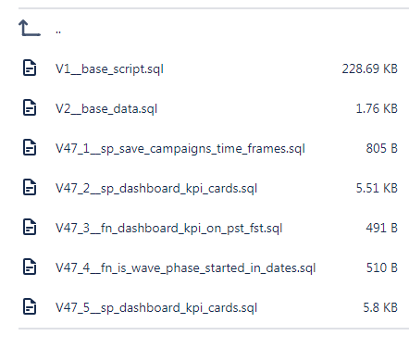
Wait, Lets check Migration based (Flyway) Example Quickly
FlyWayDB: A command-line (Java based Tool)
https://flywaydb.org/documentation/commandline/

Slide 22
What’s Next?
Discussion on Practical Scenarios
More dimensions of SSDT
More exploration of Flyway

Slide 23


Slide 24
Thank You

